Slide 1
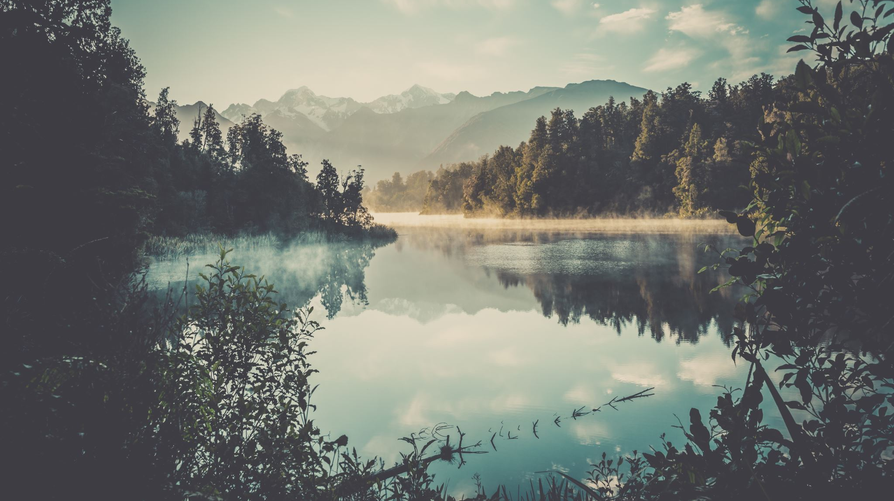
Tourish
Virtual Tours Application

Slide 2
Introduction
Our lives changed completely over Spring Break this year. Over the course of a few weeks in March, COVID-19 changed everything about how we go to school, go to work, spend time with our friends and family, and even shop for groceries. With social distancing and at times social isolation being a new (hopefully temporary) norm, we need new ways to engage with the world, keep the kids occupied, and keep our families and our selves socially and culturally connected. But how do we face this challenge?

Slide 3
Problem Statement
The problem I am trying to solve is providing an enjoyable social distancing experience to anyone interested in the arts, attractions, national parks, zoos, aquariums, or just to get away from the mundane Netflix/ Hulu/Disney+ daily activities. It may not be the same experience as going to the destination itself, but at the moment, it is the most convenient and comfortable way of experiencing many attractions because you don’t have to wear a mask and be paranoid that the person next to you might be contagious.

Slide 4
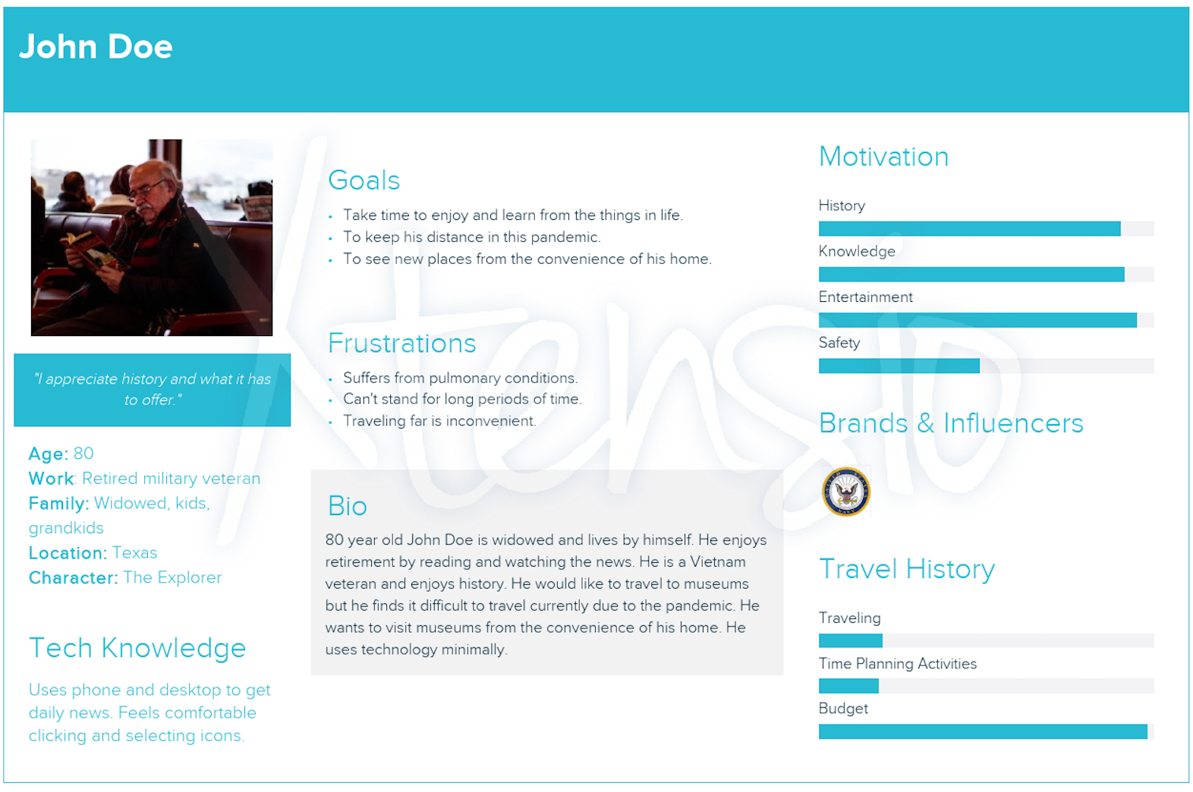
Personas

Slide 5
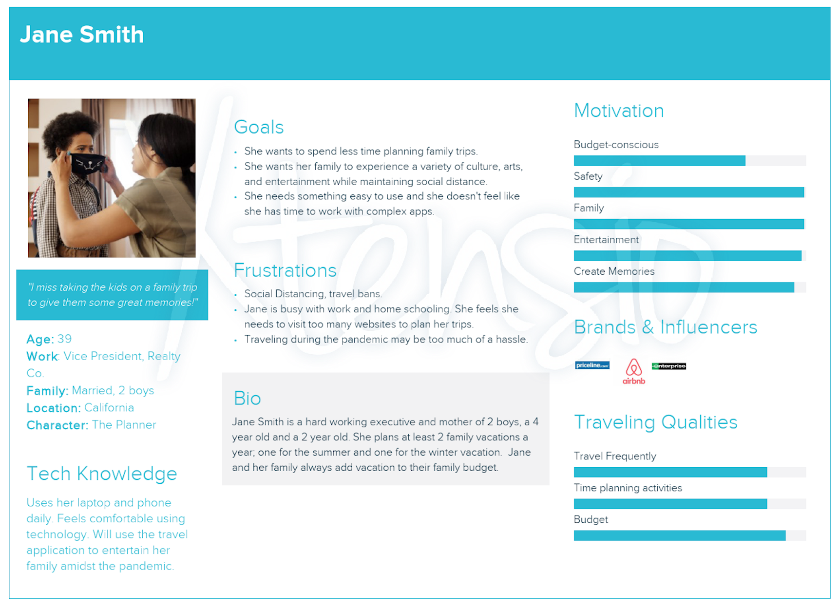

Slide 6
Solution
I initially created a responsive website called Tourish, a collection of virtual sites using React and Reactstrap (React + Bootstrap). As the project progressed, I changed the concept to a mobile application. I wanted to create a more intimate experience. With almost everyone working using their computers during the day and having Zoom or virtual meetings daily, I would assume the audience both young and old would be more comfortable having a leisure break on their phones.

Slide 7
Tools
IDE: Visual Studio Code
React Native (hybrid mobile application development) – steep learning curve
Expo CLI to scaffold React Native Starter application
Yarn package manager
Json server – perform CRUD operations without proper backend prototype
Android Emulator – slow, crashes from time to time
Android Studio
AVD Manager

Slide 8
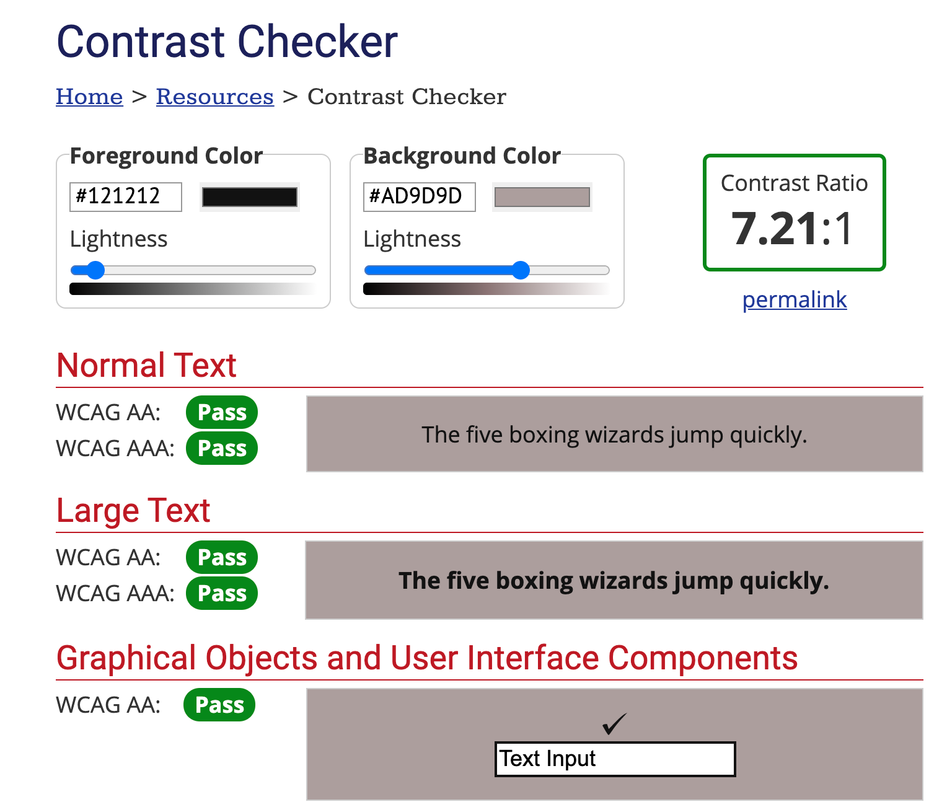
WebAim

Slide 9
Design
Wireframe. Link to Wireframe
Prototype
Final Project
https://github.com/ydavidson2021/tourishapp
Landing Page
Directory

Slide 10
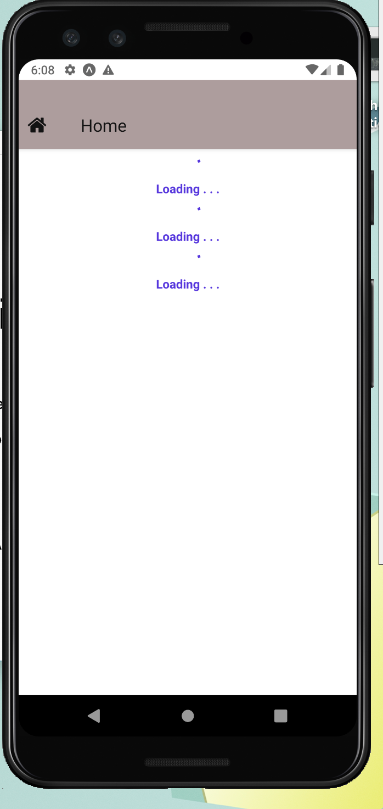
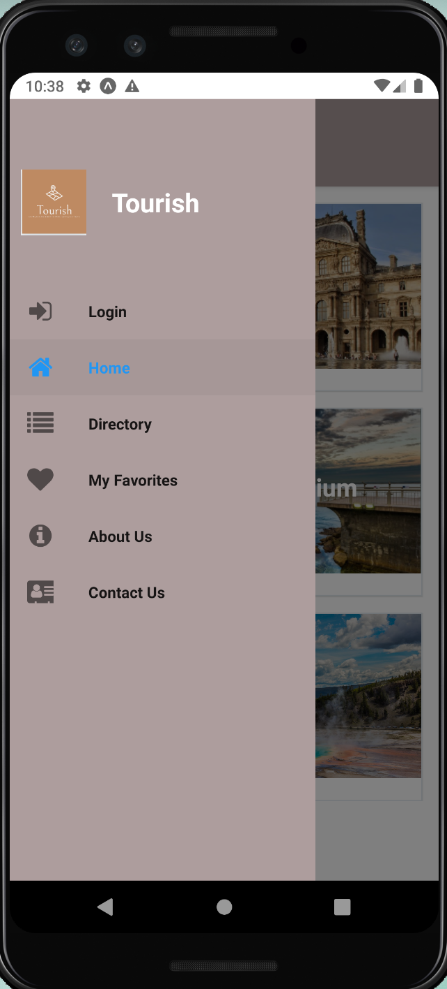
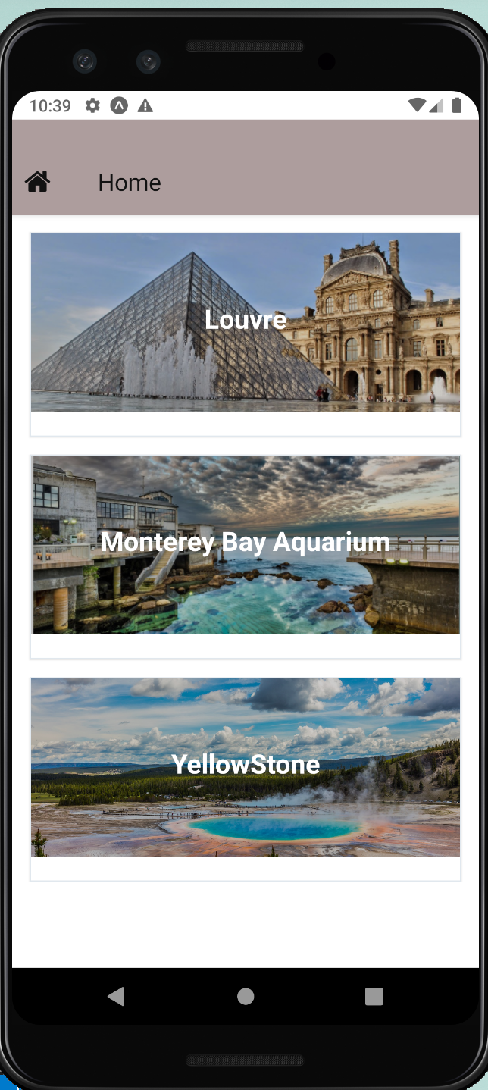
Home and Navigation

Slide 11
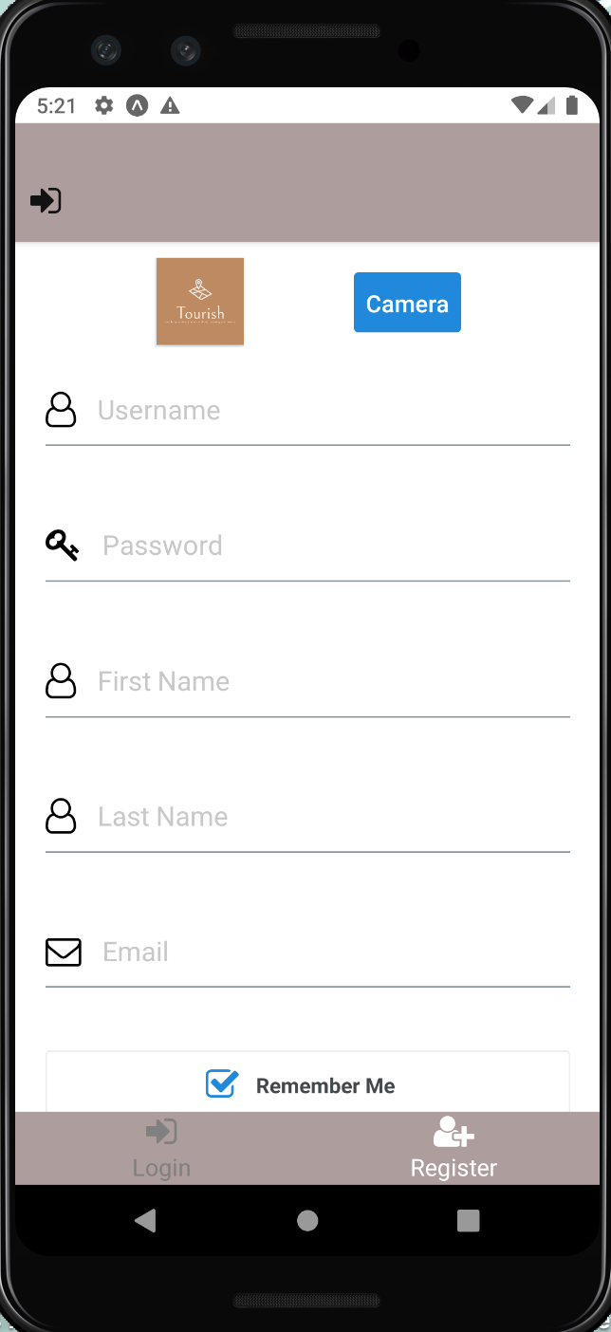
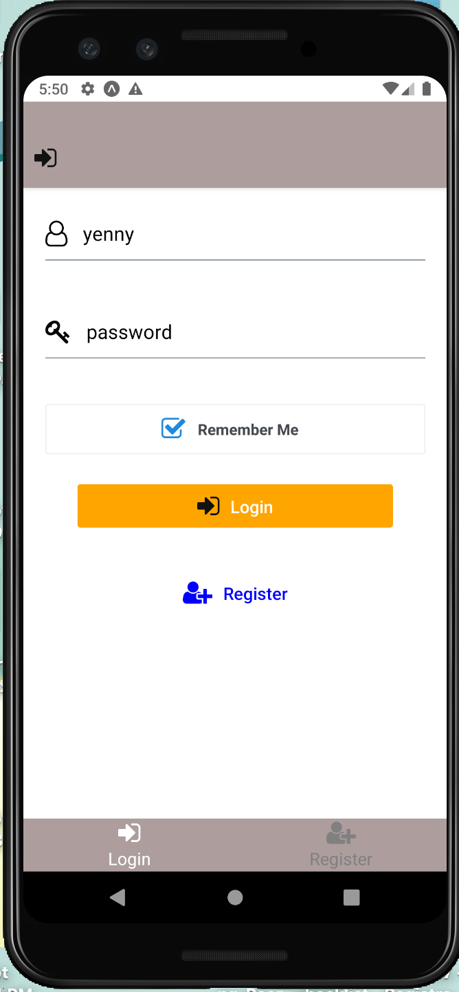
Login Page

Slide 12
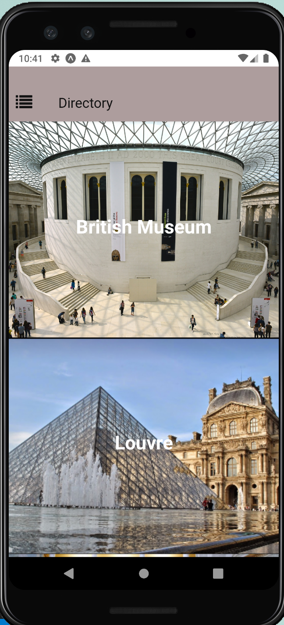
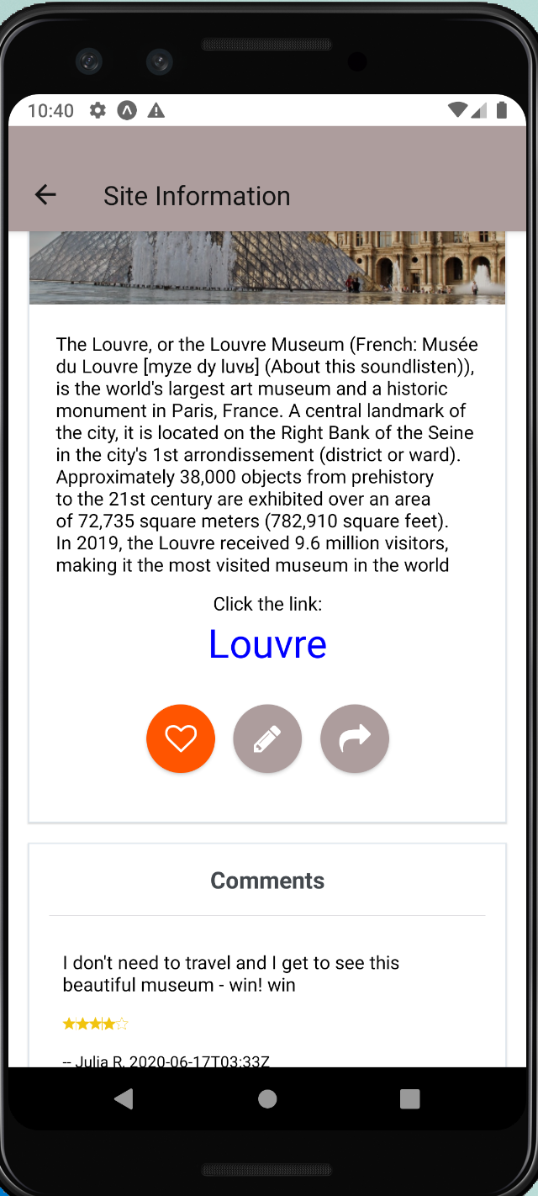
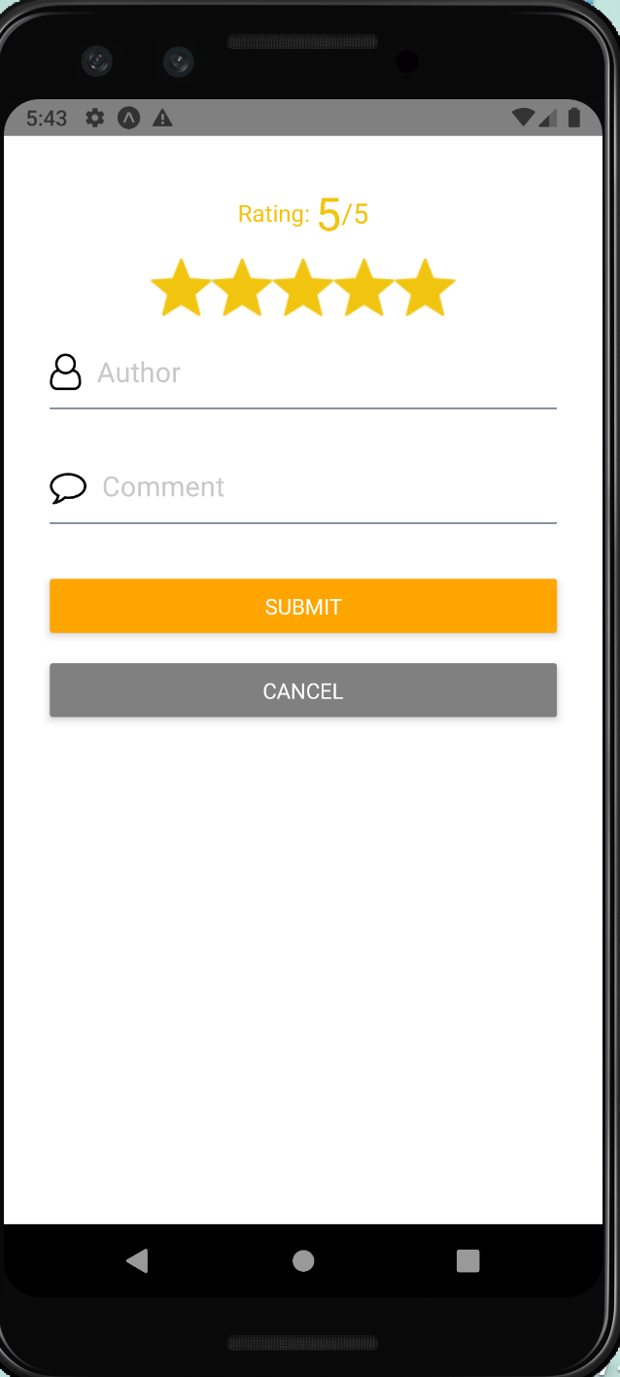
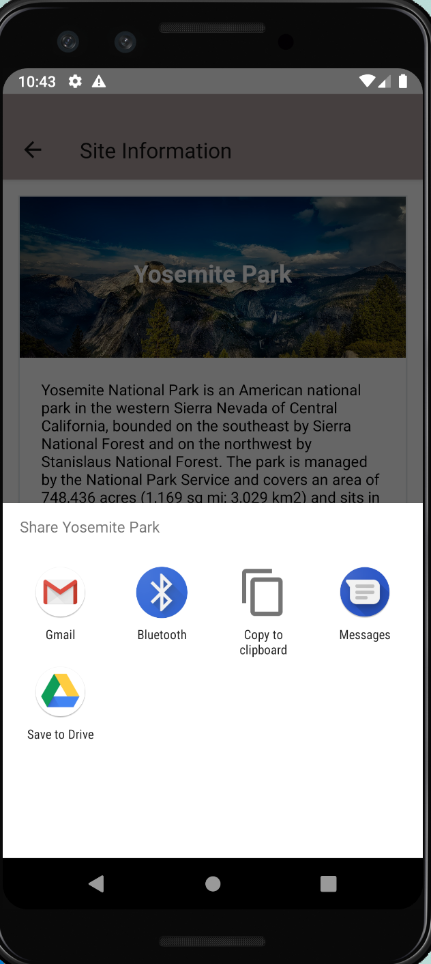
Directory

Slide 13
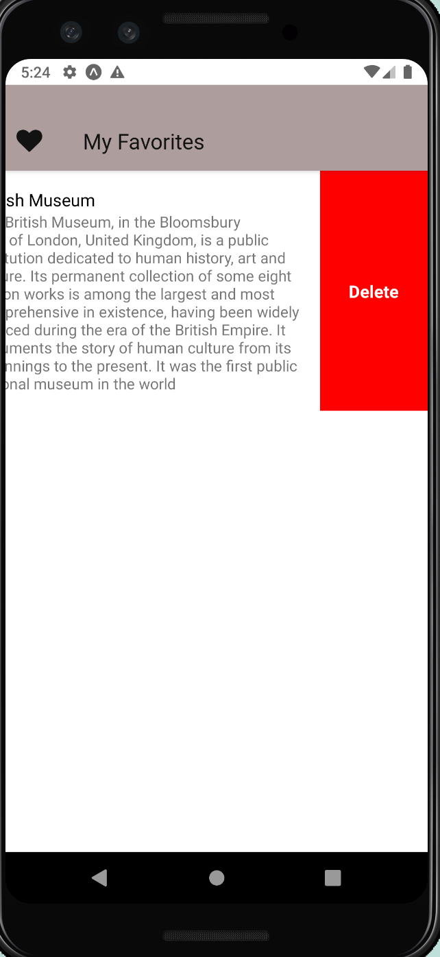
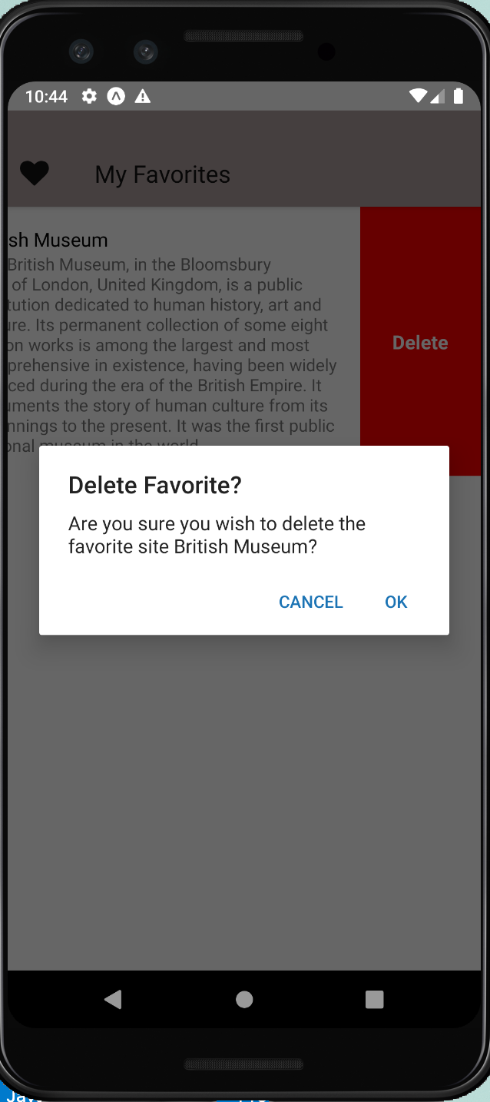
Favorites

Slide 14
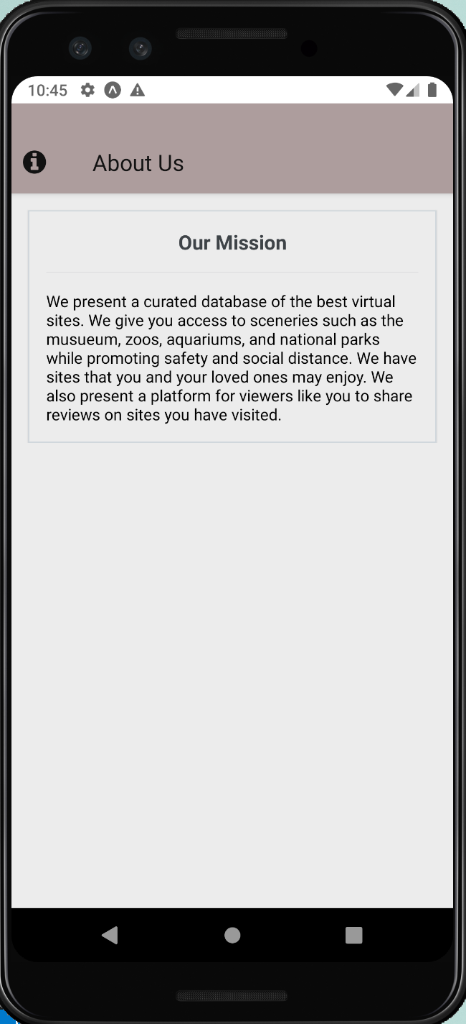
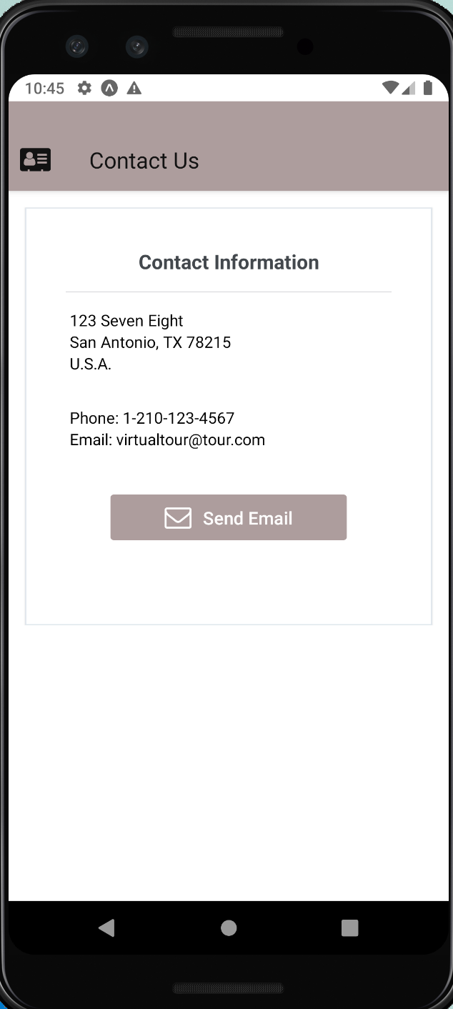
About and Contact

Slide 15
Future Work
Focus on design
Add more content and organize
Focus on back-end

Slide 16
Resource:
1. https://webaim.org/resources/contrastchecker/
2. Wikipedia
3. https://gateway.stmarytx.edu/group/mycampus/campus-life/play/satp#StuLife-Virtual
4. https://www.nucamp.co/
5. https://www.nngroup.com/articles/ten-usability-heuristics/

